Slide 1
Microcontrollers

Slide 2
Objectives
Introduction fundamentals and applications of microprocessors and microcomputers.
Architecture, the instruction set, and applications of 8051 microcontroller family
Basic applications of microprocessors, such as input/output, analog-digital conversion (ADC), and digital-analog conversion (DAC), and data acquisition.
Aspects of KIT Arduino
Ref. I. Scott Mackenzie
2

Slide 3
Textbooks
I. Scott Mackenzie, Raphael C, -W, The 8051 Microcontroller, Prentice Hall, Fourth edition.
James A. Langbridge, Arduino sketches – Tools and techniques for programming , Wiley
Tống Văn On, Hoàng Đức Hải, “Họ vi điều khiển 8051”, 2001.
Nguyễn Tăng Cường, “Cấu trúc và lập trình họ VĐK 8051”, 2003

Slide 4
Contents:
Chapter 1: Introduction to Microcontrollers
Chapter 2: 8051 microcontroller architecture
Chapter 3: C programming for 8051
Chapter 4: Arduino

Slide 5
Chap 1. Introduction to Microcontrollers
1.1. Microprocessing systems
1.2. Microcontrollers
1.3. Advanced microcontrollers
1.4. Embedded systems
1.5. Numbering and coding systems
1.6. Memory
1

Slide 6
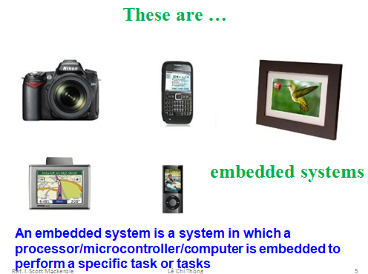
Chap 1. INTRODUCTION
1

Slide 7
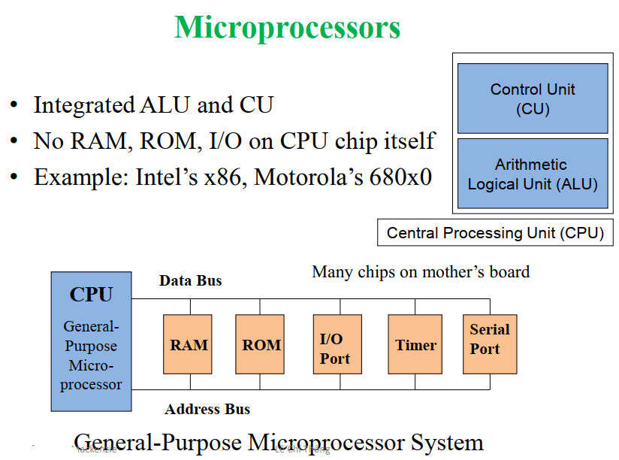
1.1 Microprocessing Systems
1

Slide 8
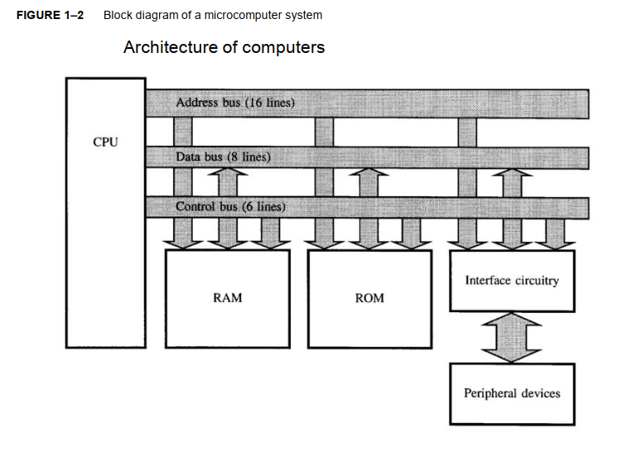
1.1 Microprocessing Systems
1

Slide 9
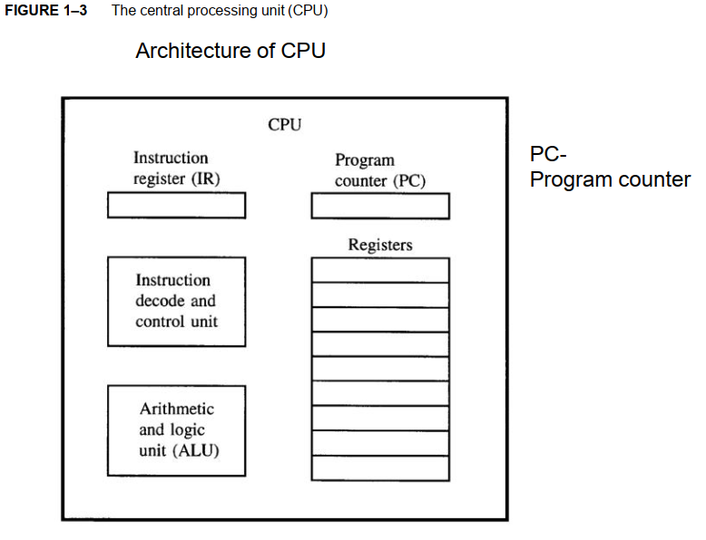
1.1 Microprocessing Systems
1

Slide 10
1.1 Microprocessing Systems
1

Slide 11
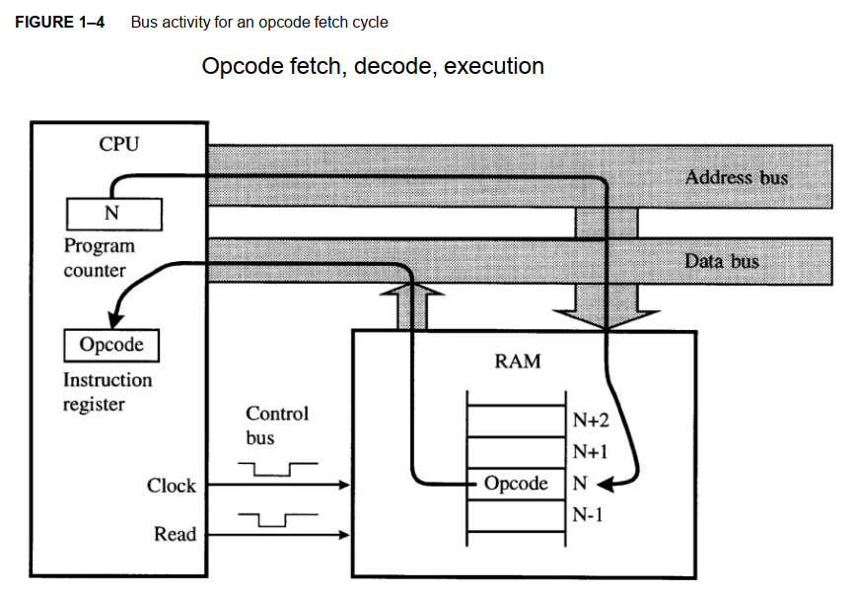
1.1 Microprocessing Systems
1

Slide 12
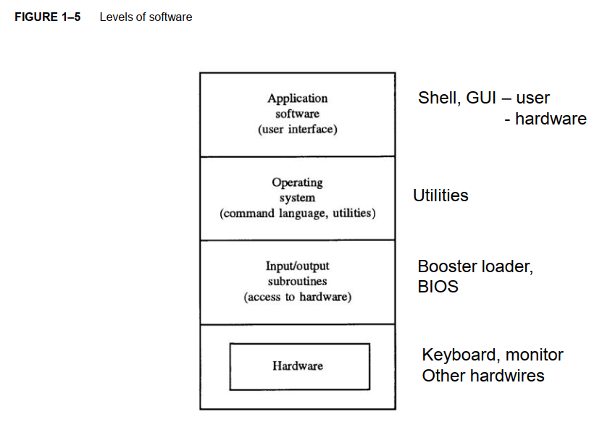
1.1 Microprocessing Systems
1

Slide 13
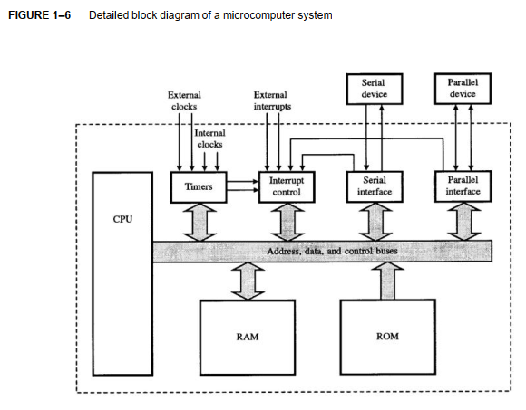
1.1 Microprocessing Systems
1

Slide 14
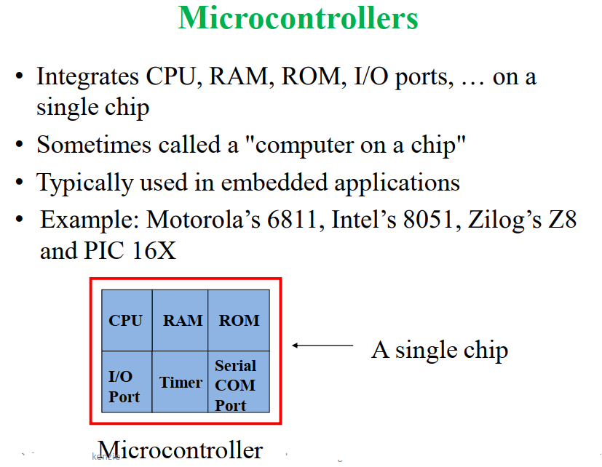
1.2 Microcontrollers
1

Slide 15
1.2. Microcontrollers
Microprocessor vs. Microcontroller
Microprocessor
CPU is stand-alone, RAM, ROM, I/O, timer are separate
designer can decide on the amount of ROM, RAM and I/O ports.
Expansive
Versatility
general-purpose
Microcontroller
CPU, RAM, ROM, I/O and timer are all on a single chip
fix amount of on-chip ROM, RAM, I/O ports
Highly bit addressable
for applications in which cost, power and space are critical
single-purpose

Slide 16
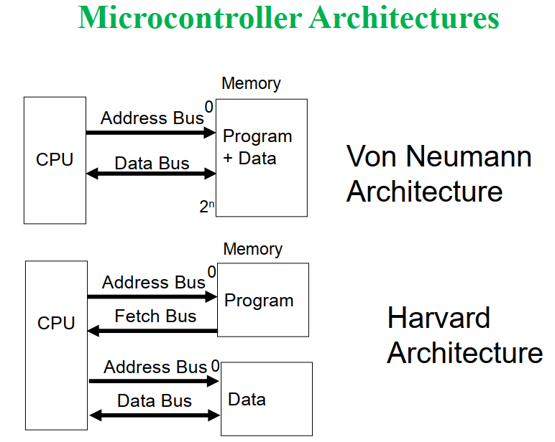
1.2. Microcontrollers
1

Slide 17
1.3. Advanced microcontrollers
AVR microcontrollers
PIC microcontrollers
ARM architecture

Slide 18
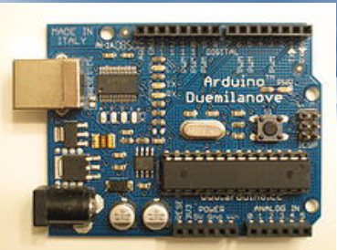
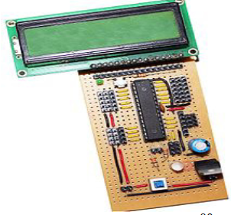
AVR Microcontroller

Slide 19
AVR general features
Enhanced RISC architecture with mostly fixed – length instruction, load-store memory access and 32 general-purpose registers.
A two – stage instruction pipeline that speeds up excution
Majority of instructions take one clock cycle
Up to 10Mhz clock operation
Wide variety of on-chip peripherals, including digital I/O, ADC, EEPROM, Timers, UART, RCT timer, PWM etc.
Internal program and data memory

Slide 20
AVR general features
In-System programmable (ISP)
Available in 8 pin to 64 pin size to suit wide variety of applications
Up to 12 times performance speedup over conventional CISC controllers
Wide operating voltage from 2.7 to 6.0 V
Simple architecture offers a small learning curve to uninitiated

Slide 21
What does AVR RISC mean?
The acronym AVR has been reported to stand for: Advanced Virtual RISC and also for the chip’s designers: Alf-Egil Bogen and Vegard Wollan who designed the basic architecture at the Norwegian Institute of Technology.
RISC stands for Reduced Instruction Set Computer
CPU design with a reduced instruction set as well as a simpler set of instructions ()

Slide 22
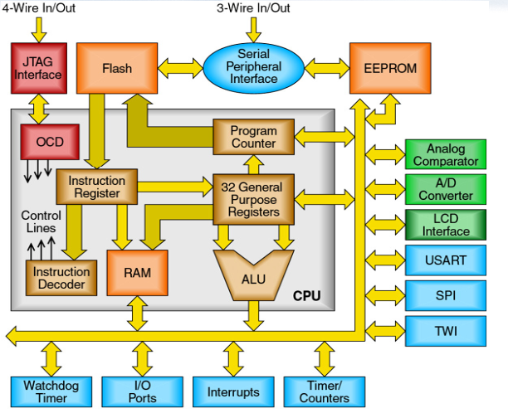
AVR architecture

Slide 23
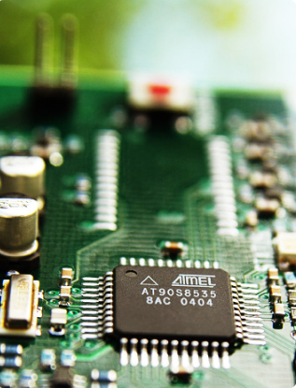
AVR Mega 8 features
8 Kbyte self-programming flash program memory
1-kbyte SRAM
512 byte EEFROM
6 or 8 channel 10 bit A-D converter.
Up to 16 MIPS throughput

Slide 24
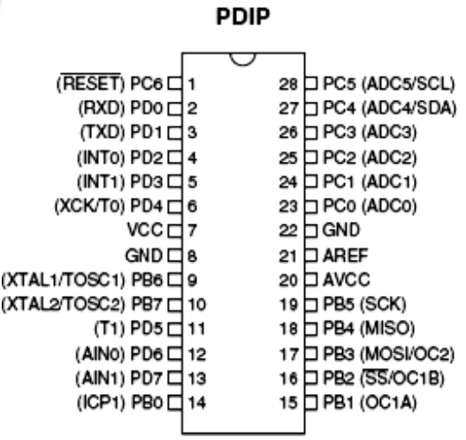
AT Mega 8 pinout

Slide 25
Atmega 16 Features
131 instructions
32 8-bit GP registers
Throughput up to 16 MIPS
16K programmable flash (instructions)
512 Bytes EEPROM
1K internal SRAM
Timers, serial and parallel I/O, ADC

Slide 26
AVR memory
Flash: machine instructions go here
SRAM: for runtime data
Note bus independence for data and instructions
EEPROM: secondary storage
EEPROM and Flash memories have a limited lifetime of erase/write cycles

Slide 27
PIC microtrontroller
PIC stands for Peripherals Interface Controller
The general instruments used the acronyms Programmable Interface Controller and Programmable Intelligent Computer for the initial PICs (PIC 1640 and PIC 1650)
In 1993, Microchip Technology launched the 8-bit PIC 18F84 with EEPROM which could be programmable using serial method
The improved version of PIC16c84 with flash memory (PIC18F84 and PIC18F84A) hit the market in 1998

Slide 28
Development
Since 1998, Microchip Technology continuously developed new high performance microcontrollers with new complex architecture and enhanced in-built peripherals.
PIC microcontroller is based on Harvard architecture.
At present PIC microcontrollers are widely used for industrial purpose due to its high performance ability at low power consumption.
It is also very famous among hobbyists due to moderate cost and easy availability of its supporting software and hardware tools like compilers, simulators, debuggers, etc…

Slide 29
Development
The 8-bit PIC microcontroller is divided into following four categories on the basic of internal architecture:
Base line PIC
Mid-range PIC
Enhanced Mid-range PIC
PIC18

Slide 30
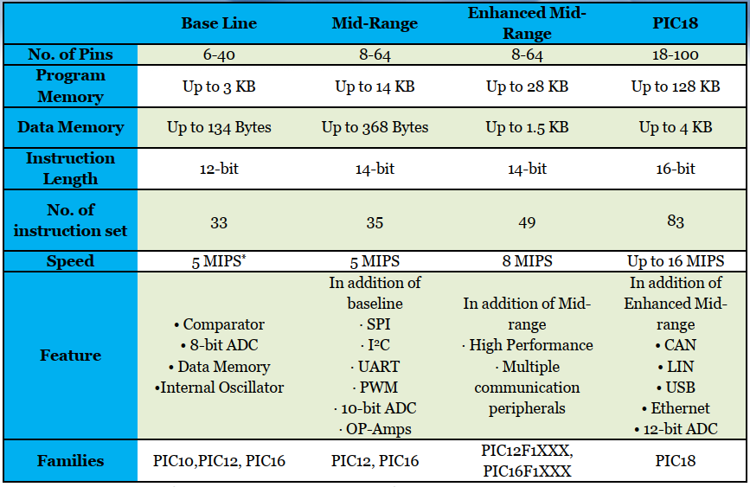

Slide 31
PIC microcontrollers
Architecture
PIC microcontrollers are based on advanced RISC architecture
RISC stands for Reduced Instruction Set Computing
In this architecture, the instruction set of hardware gets reduced with increases the execution rate (speed) of system.
PIC microcontrollers follow Harvard architecture for internal data transfer
In Harvard architecture there are two separate memories for program and data
These two memories are accessed through different buses for data communication between memories and CPU core.

Slide 32
PIC microcontrollers
Architecture
This architecture improves the speed of system over Von Neumann architecture in which program and data are fetched from the same memory using the same bus
PIC18 series controllers are based on 16 bit instruction set
The question may arise that if PIC18 are called 8-bit microcontrollers, then what about them being based on 16 bit instructions set.
PIC18 is an 8bit microcontroller this statement means that the CPU core can receive/transmit or process a maximum of 8bit data at a time

Slide 33
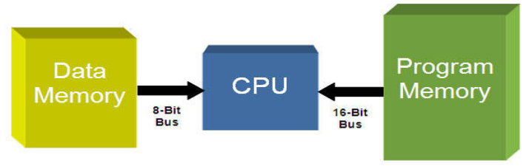
PIC microcontrollers
Architecture
On the other hand the statement PIC18 microcontrollers are based on 16 bit instruction set’s means that the assembly instruction sets are of 16 bit
the data memory is interfaced with 8 bit bus and program memory is interfaced with 16 bit bus as depicted in the following figure

Slide 34
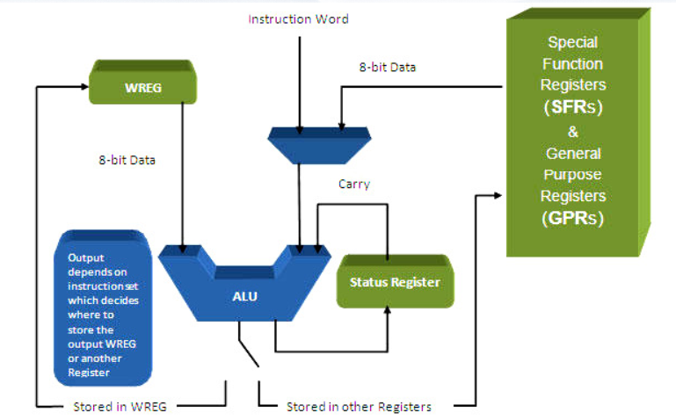
PIC microcontrollers
PIC18 Harvard Architecture

Slide 35
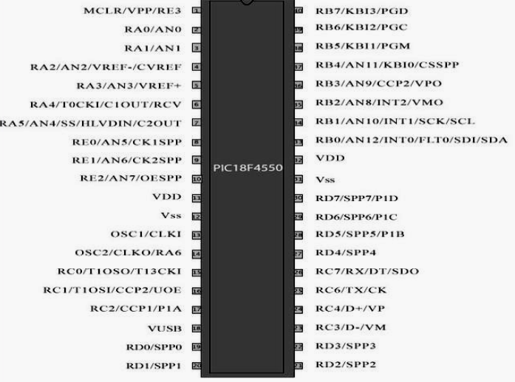
PIC microcontrollers

Slide 36
PIC microcontrollers
Arithmetic Logic Unit (ALU)
Instruction decoder
16 bits instructions
Status register that stores flags
5 bits
WREG-working register
8bit accumulator
Registers
Program counter (PC)
21 bit register that hold the Program Memory address
Bank select Register (BRS)
4 bit register used in direct addressing the Data Memory
File select registers (FSRs)
12 bit registers used as memosy pointers in indirect addressing Data memory

Slide 37
PIC microcontrollers
Address bus
21 bit address bus for Program Memory
Addressing capacity: 2MB
12 bit address bus for data memory
Addressing capacity : 4KB
Data bus
16 bit instruction/data bus for program memory
8bit data bus for data memory
PIC18F452/4520 Memory
Program memory: 32k
Data memory: 4K
Dara EEPROM:
Not part of the data memory spave
Addressed through special function registers

Slide 38
PIC microcontrollers
Specical feature
Slepp mode
Watchdog timer
Code protection
In-circuit serial programming
In circuit debugger

Slide 39
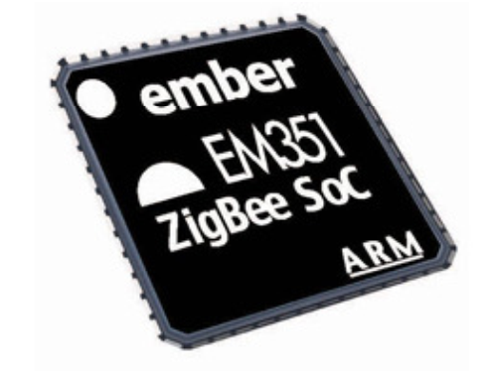
AVR microcontroller
The ARM is a 32 bit reduced instruction set computer (RISC) developed by ARM holdings.
It was known as the Advanced RISC Machine

Slide 40
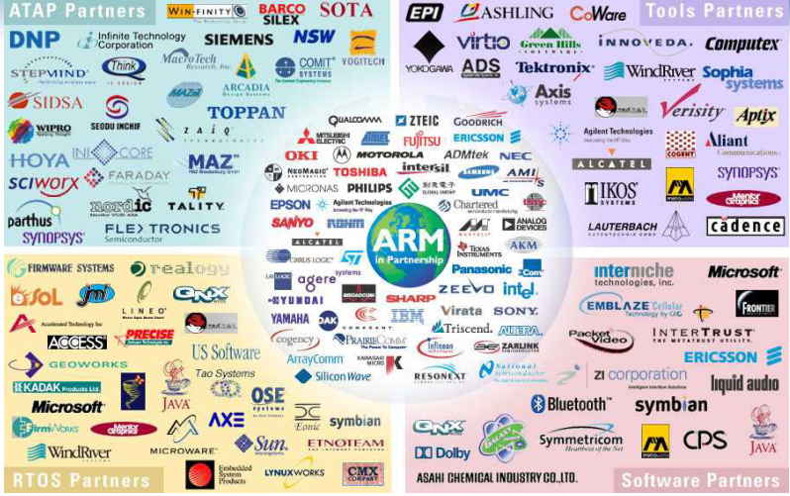
ARM Partnership Model

Slide 41
Introduction
Leading provider of 32 bit embdded RISC microprocessors , 75% of market.
High performance
Low power consumption
Low system cost
Solutions for:
Embedded read-time systems for mass storage, automotive, industrial and networking applications.
Secure applications – smartcards and SIMs
Open platforms running complex operating systems Low system cost

Slide 42
Introduction
ARM v1:
First version of ARM processor
26-bit addressing, no multiply/coprocessor
ARM v2:
First commercial chip
Included 32-bit result multiply instructions/coprocessor support
ARM v2a:
ARM3 chip with on-chip cache
Added load and store cache management
ARM v3:
ARM6, 32 bit addressing, virtual memory support

Slide 43
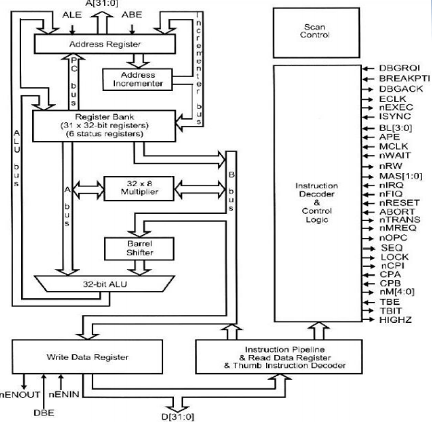
ARM core diagram

Slide 44
The registers
ARM has 37 registers all of which are 32 bits long
The current processor mode govern which of several banks is accessible. Each mode can access
a particular set of r0-r12 registers
a particular r13 (the stack pointer, sp) and r14 (the link register)
The program counters, r15 (pc)
the current program status registers, cpsr
Privileged mode (except system ) can also access
A particular spsr (saved program status register)

Slide 45
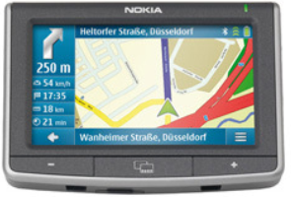

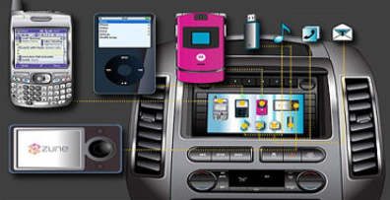
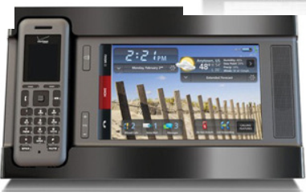
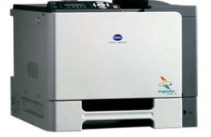
ARM Applications

Slide 46
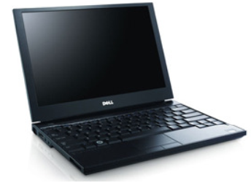
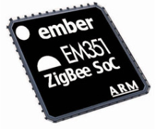
ARM cortex M applications
Dell E4300 Latitude Laptop
instant boot-up for users and access to select applications, with multi-day battery lifetimes

Slide 47
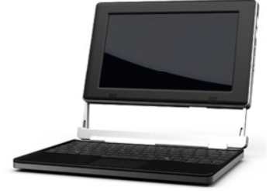
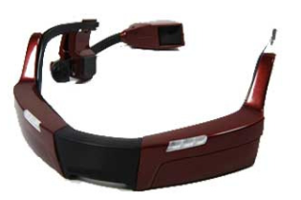

ARM cortex A applications

Slide 48
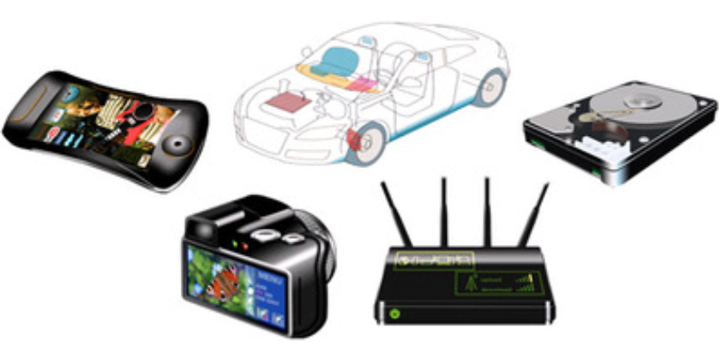
ARM cortex R applications

Slide 49
Real life applications
Complete Navigation application
c bitfields
Car radio control
DES Encryption/Decryption
Three different modules from analog telephones
Battery charge
Embedded Web server

Slide 50
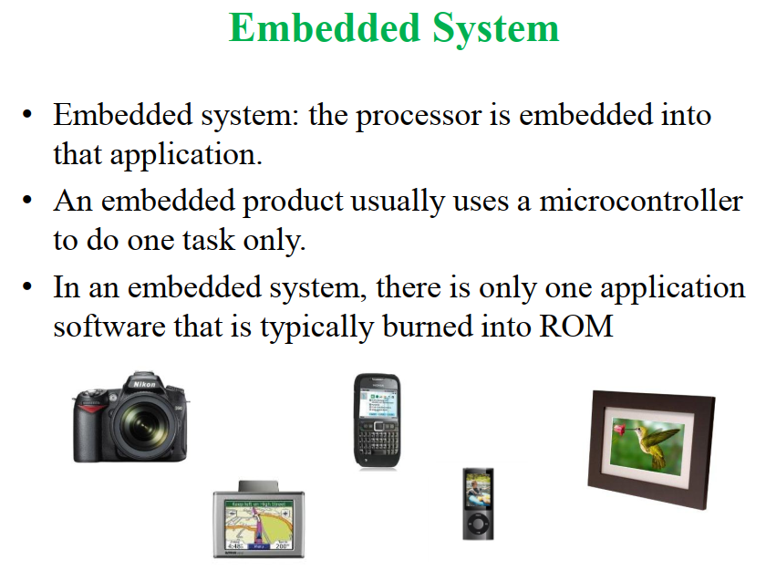
1.4. Embedded system
1

Slide 51
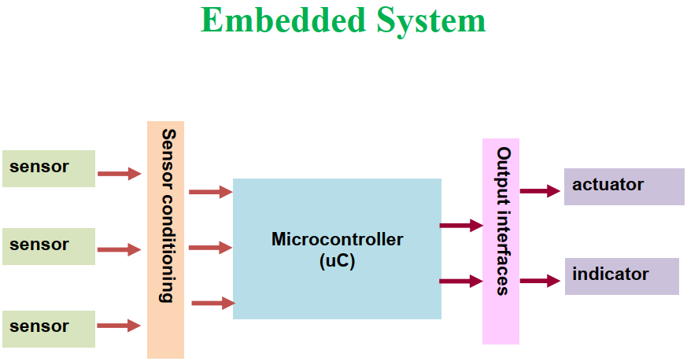
1.4. Embedded system
1

Slide 52
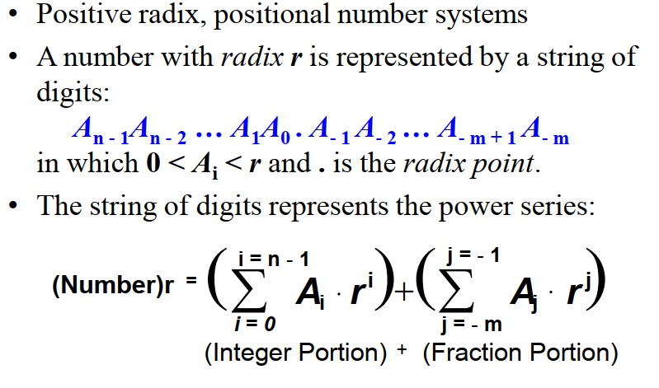
1.5. Numbering and coding systems
1

Slide 53
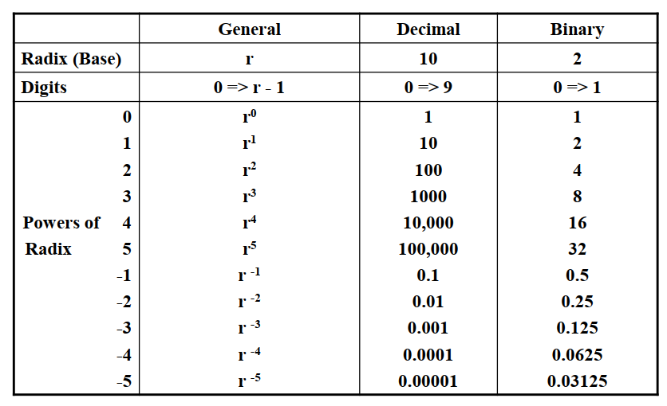
1.5. Numbering and coding systems
1

Slide 54
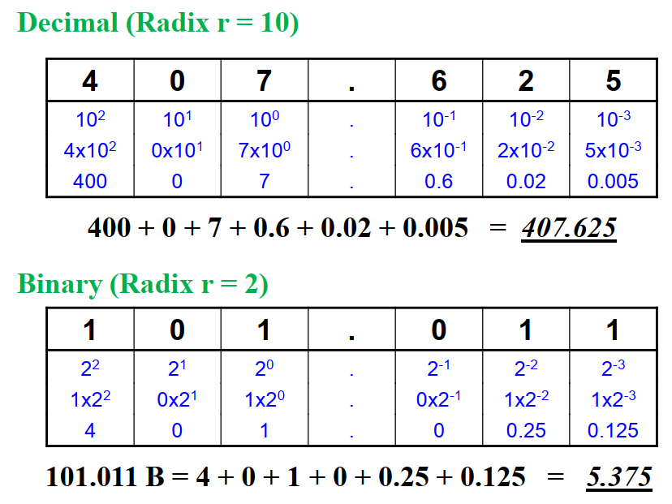
1.5. Numbering and coding systems
1

Slide 55
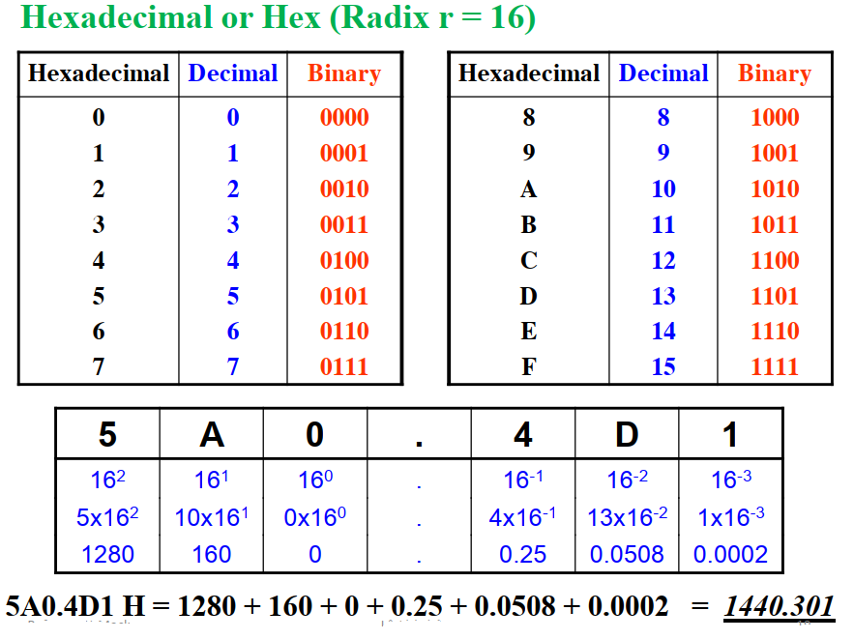
1.5. Numbering and coding systems
1

Slide 56
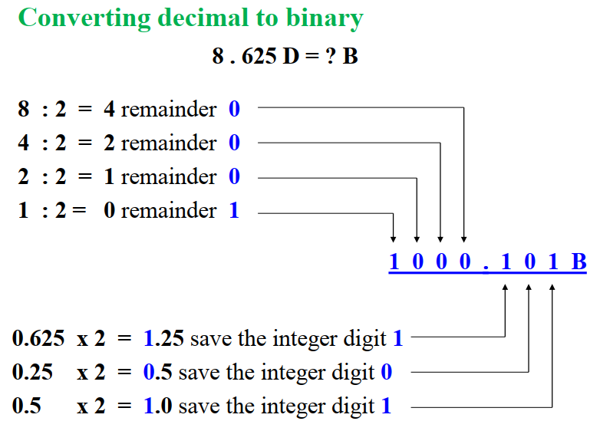
1.5. Numbering and coding systems
1

Slide 57
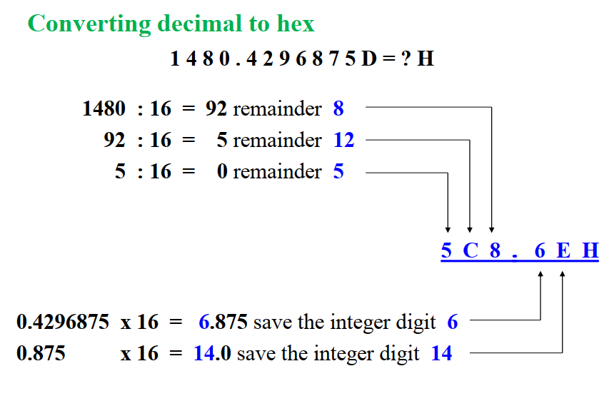
1.5. Numbering and coding systems
1

Slide 58
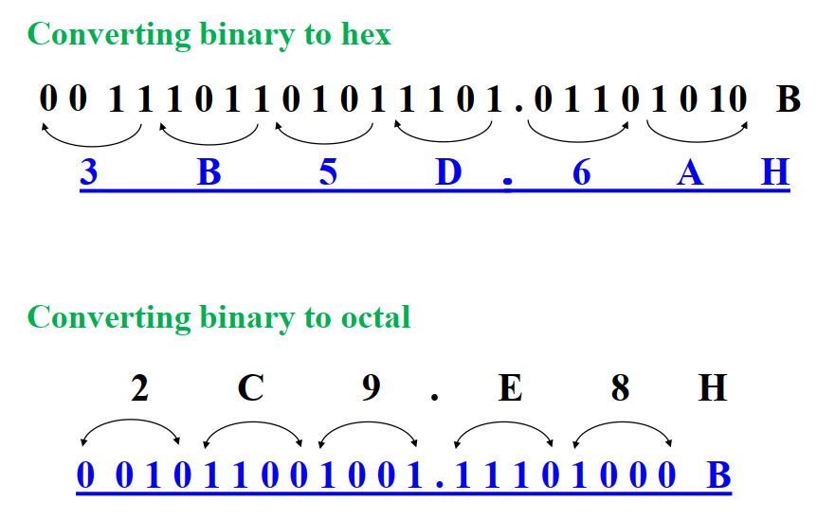
1.5. Numbering and coding systems
1

Slide 59
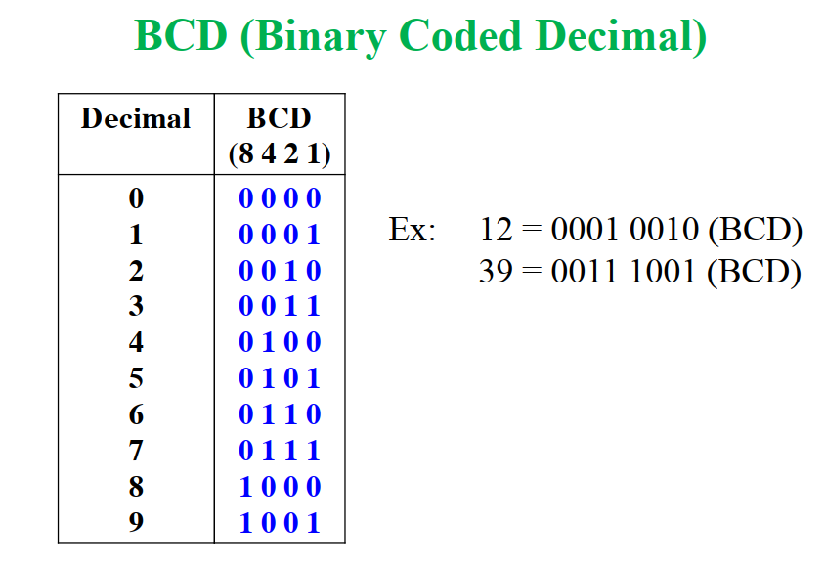
1.5. Numbering and coding systems
1

Slide 60
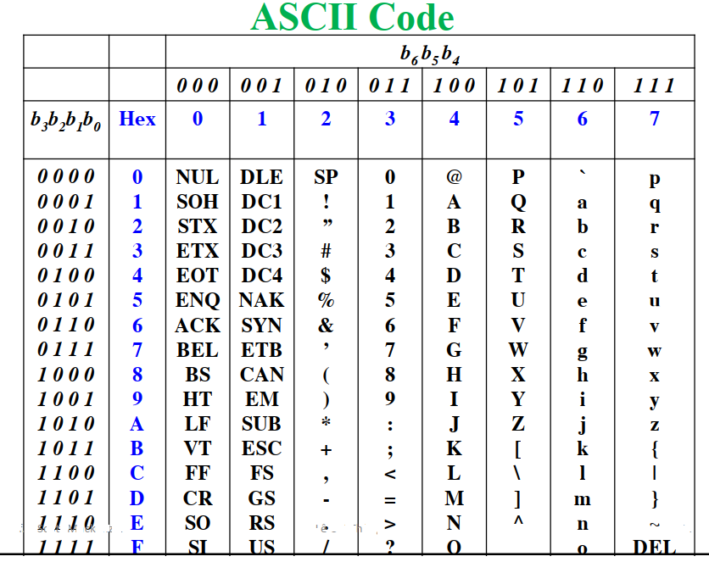
1.5. Numbering and coding systems
1

Slide 61
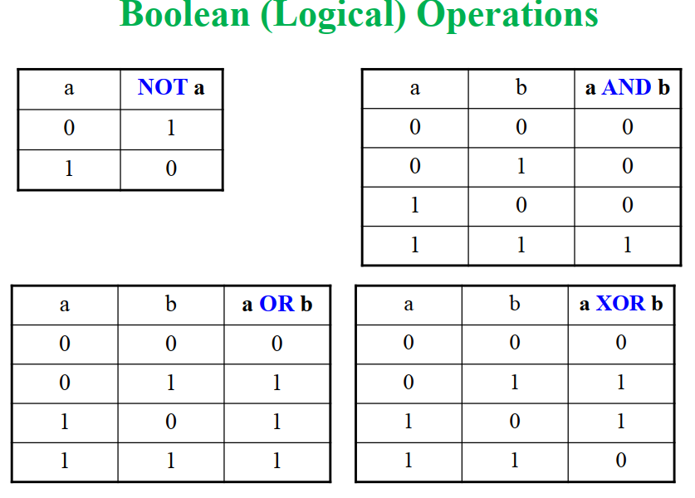
1.5. Numbering and coding systems
1

Slide 62
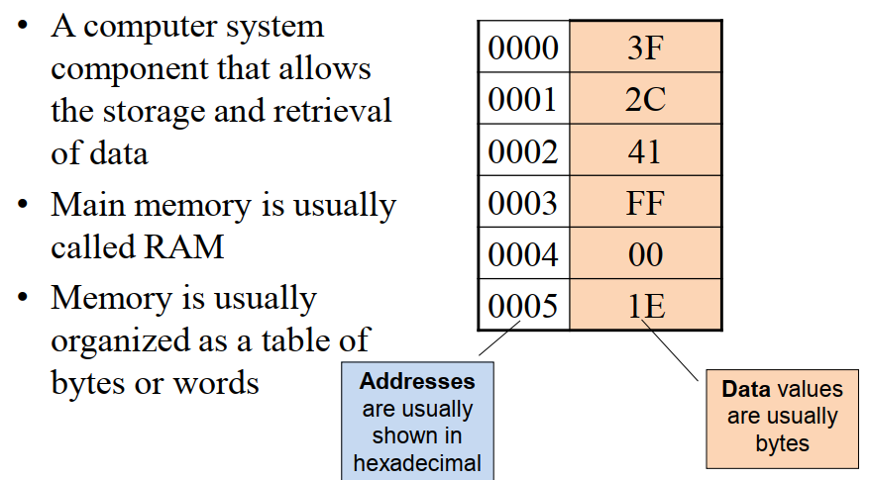
1.6. Memory
1

Slide 63

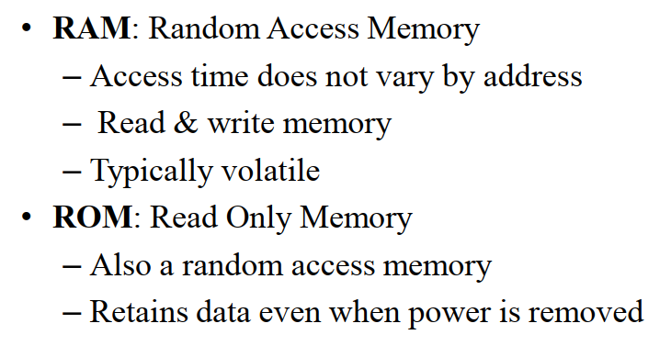
1.6. Memory
1

Slide 64
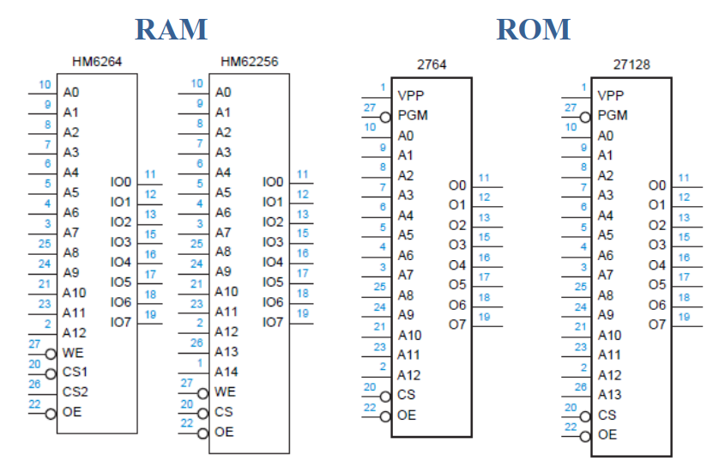
1.6. Memory
1

